Slide 1
Ancient Egypt 101
3000 years of history in 30 minutes

Slide 2
Pyramids
Pyramids
Tombs were built as burial tombs for Kings
Great Pyramid at Giza (2500 BC)
Tomb for King Khufu
Took about 20 years to build
20,000 men to build

Slide 3
Death
Physical body remained on earth in order to proceed into the afterlife
Bigger and better version of Ancient Egypt
Kings would live with other Gods in afterlife
Mummification
Organs embalmed
Brains sucked through the nose
Bodies dried out with salts
Skin rubbed with oils
Hair and make-up done
Wrapped in Linen
Buried in sarcophagus

Slide 4
Religion
Polytheistic
Re- Sun God
Chief God
Animals were sacred
Animals would be mummified with their owners so they could continue in the afterlife as well

Slide 5
Government
Pharaohs
Kings
Famous Kings
Tutankhamun
Akhenaten
Height of wealth and power
Abolished all Gods and replaced with single God
Ramesses
Cleopatrah
Last pharah of Ancient Egypt (30 BC)

Slide 6
Daily Life
Environment
Nile River Delta
Used to build ditches for drainage and irrigation
Provided water for drinking, cooking, etc.
Life Expectancy
Most people lived to be around 40
Lower than most ancient civilizations
Parasites
Food
Grains
Medicine

Slide 7
Writing
Hieroglyphics
Ancient sacred texts
Very ornate symbols
Demotic
Everyday writing
Rosetta Stone
Found in 18th century by the French
Hieroglyphics, demotic, and Greek text
Dictionary

Slide 8
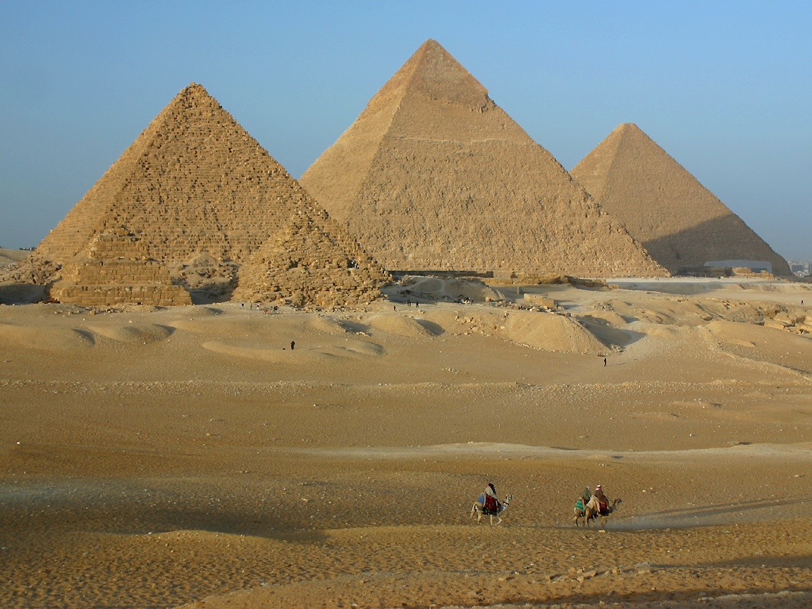
Pyramids at Giza

Slide 9
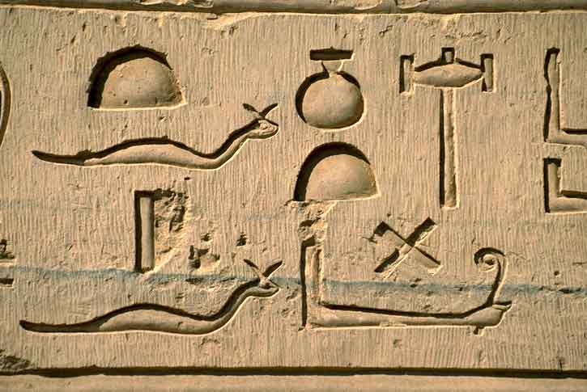
Hieroglyphics

Slide 10
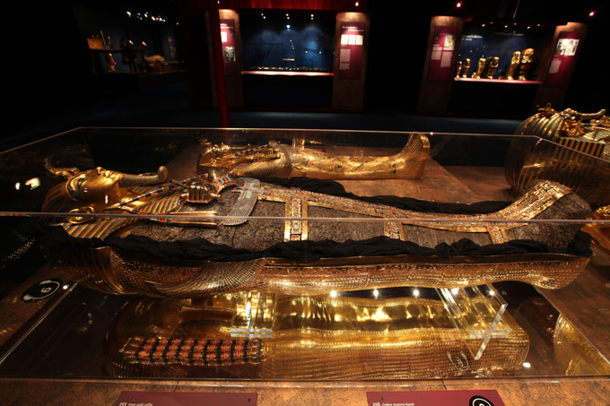
King Tutankhamen

Slide 11
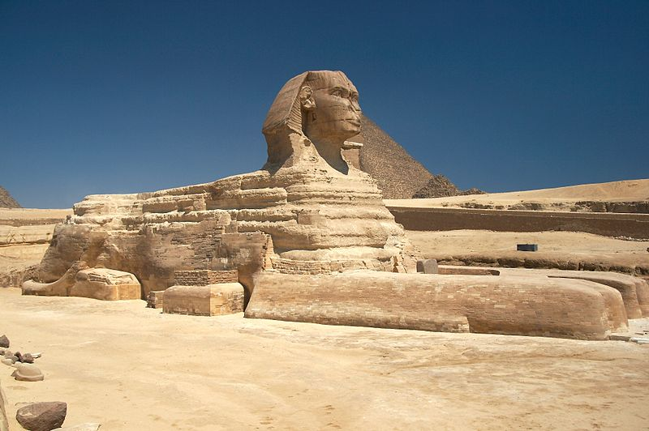
The Great Sphinx at Giza

