Slide 1
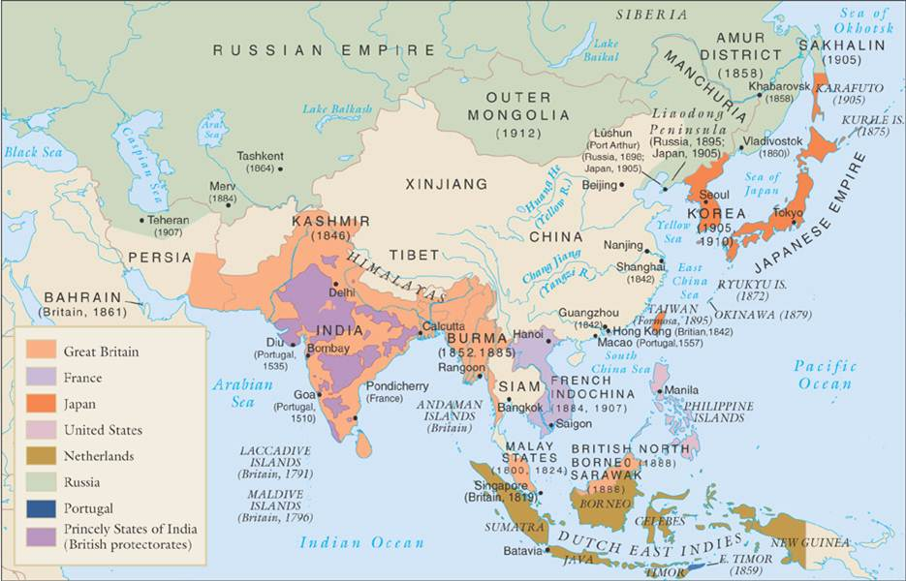
European Imperialism in Asia

Slide 2
China
China had a long history of restricting foreign trade.
By the 1700s, two developments were challenging this strategy:
Chinese decline
The Industrial Revolution

Slide 3
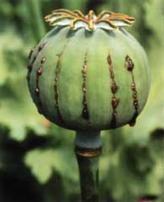
China: The Opium War
1700s: British merchants begin trading opium to China in exchange for tea.
Chinese quickly became addicted to the drug.
Chinese economy soon crashed.

Slide 4
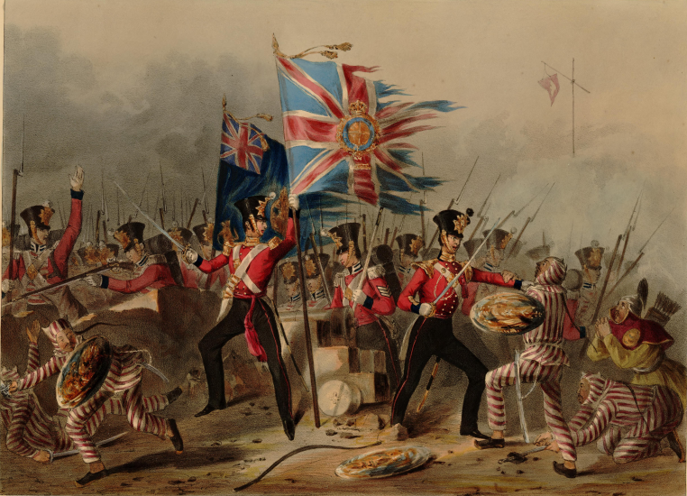
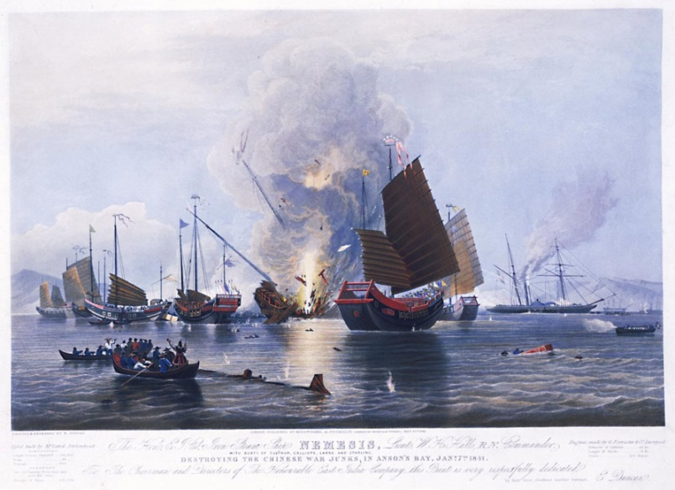
China: The Opium War
Chinese government outlawed opium, and asked Britain to stop the trade.
British refused, citing right of free trade
1839: Chinese warships begin clashing with British merchants.

Slide 5
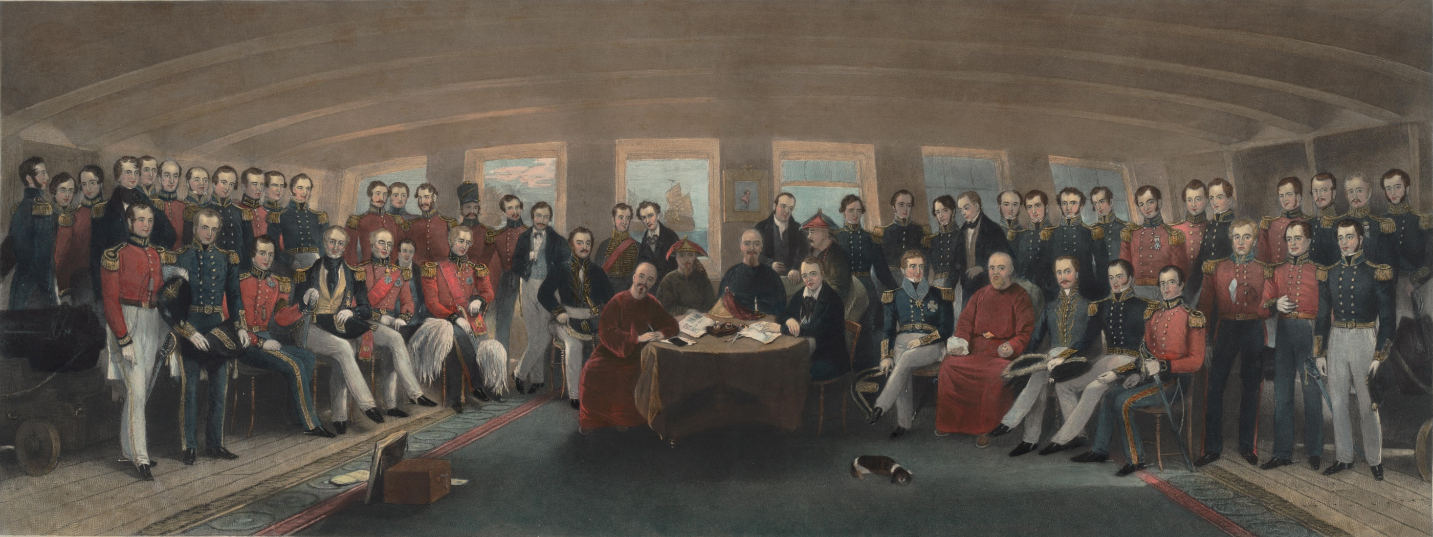
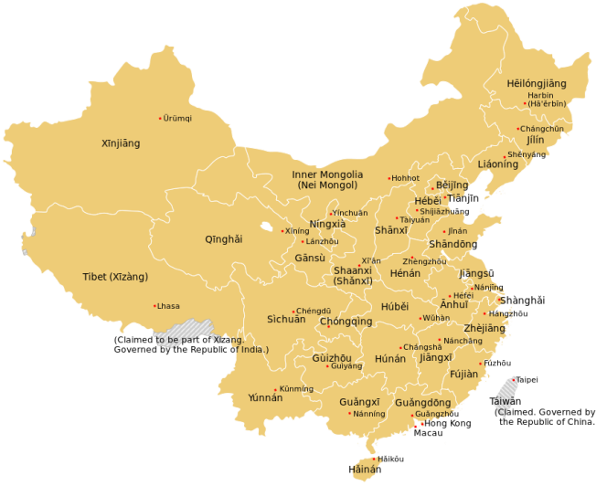
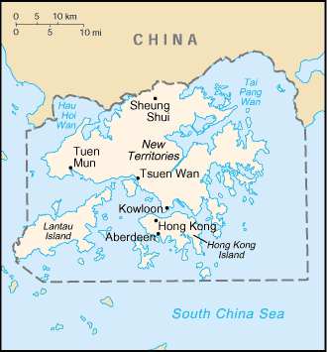
China: The Opium War
1842: War ends with Britain, forcing China to accept the Treaty of Nanjing:
Britain received war reparations
Britain received island of Hong Kong
China forced to open five ports
China forced to grant British citizens extraterritoriality

Slide 6
China Under Colonial Rule
Due to internal turmoil, war with Japan, and an economic crises, China soon fell victim to many colonial powers.
1912: Republic of China established.

Slide 7
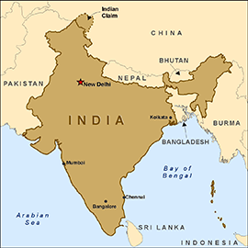
India
For more than 200 years, Mughal rulers governed a powerful empire in India.
Mid-1700s: Empire begins to collapse.
British begin exploiting crumbling empire.

Slide 8
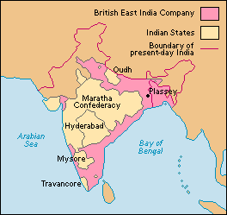
East India Company
Trade agreements gave Britain access to crumbling Mughal Empire.
British used military strength and political ploys to overthrow India.
1850: East India Company controlled 3/5 of India.

Slide 9
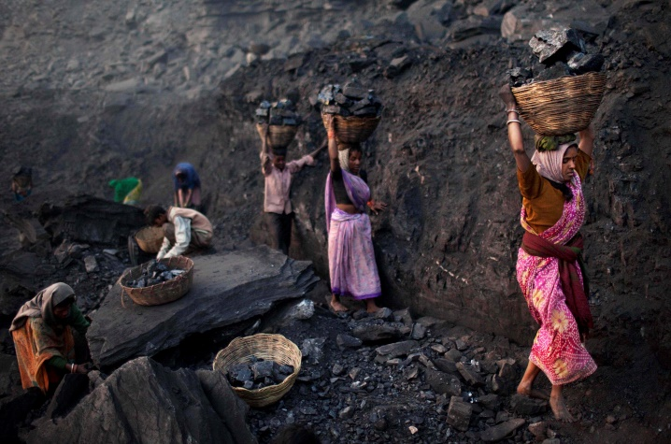
Colonization of India
Britain wanted India’s cotton, jute, and coal.
Also sought to convert Hindus, civilize India’s law code, and enhance human rights.
1858: British Raj, or viceroy, established.

Slide 10
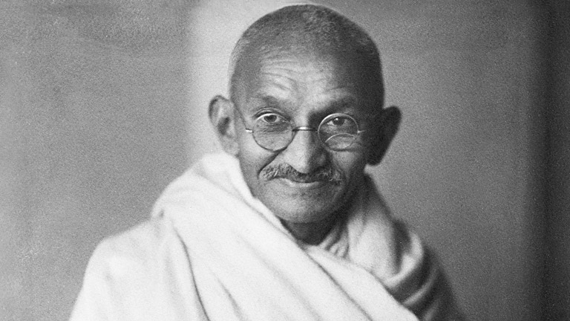
Indian Independence
Cultural differences prevented the two peoples from a harmonious relationship.
1947: India secures independence from Britain

