Slide 1
Capitalism vs. Socialism

Slide 2
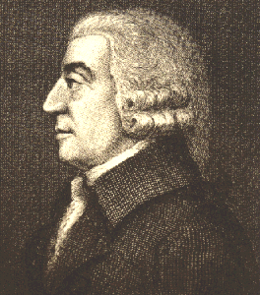
Capitalism
Founder: Adam Smith
Private ownership of business and property
Competition: encouraged

Slide 3
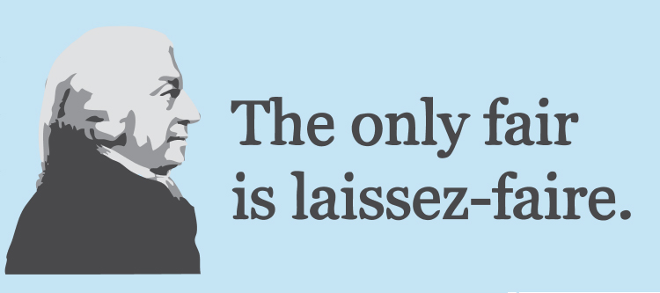
Capitalism
Goal: Private business to compete
Laissez Faire: abstention by governments from interfering in the workings of the free market

Slide 4
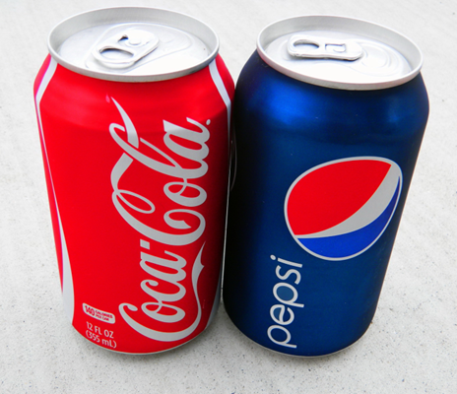
Capitalism
Private businesses compete to produce the best products and services for consumers.
The free market can solve economic problems through competition and free trade.

Slide 5
Capitalism
Pros
  Competition encourages innovation
  Economic incentives
  Economic freedom
Cons
  Unequal distribution of wealth
  Boom and bust cycles
  Monopoly power

Slide 6
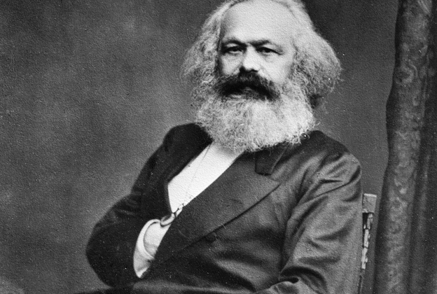
Socialism
Founder: Karl Marx
Government ownership of business and property
Competition: discouraged

Slide 7

Socialism
Goal: classless society
Proletariat: workers, or working-class people, regarded collectively.

Slide 8
Socialism
Economic system based on equality that would provide guaranteed healthcare, housing, jobs, educations, and pensions for all citizens.
To carry out these costly public benefits, government would own the property and wealth of a nation and put them to use for the common good.

Slide 9
Socialism
Pros
  Social equality
  Economic equality
  Medical equality
Cons
  Lack of competition
  Few economic incentives
  Government oversight

Slide 10
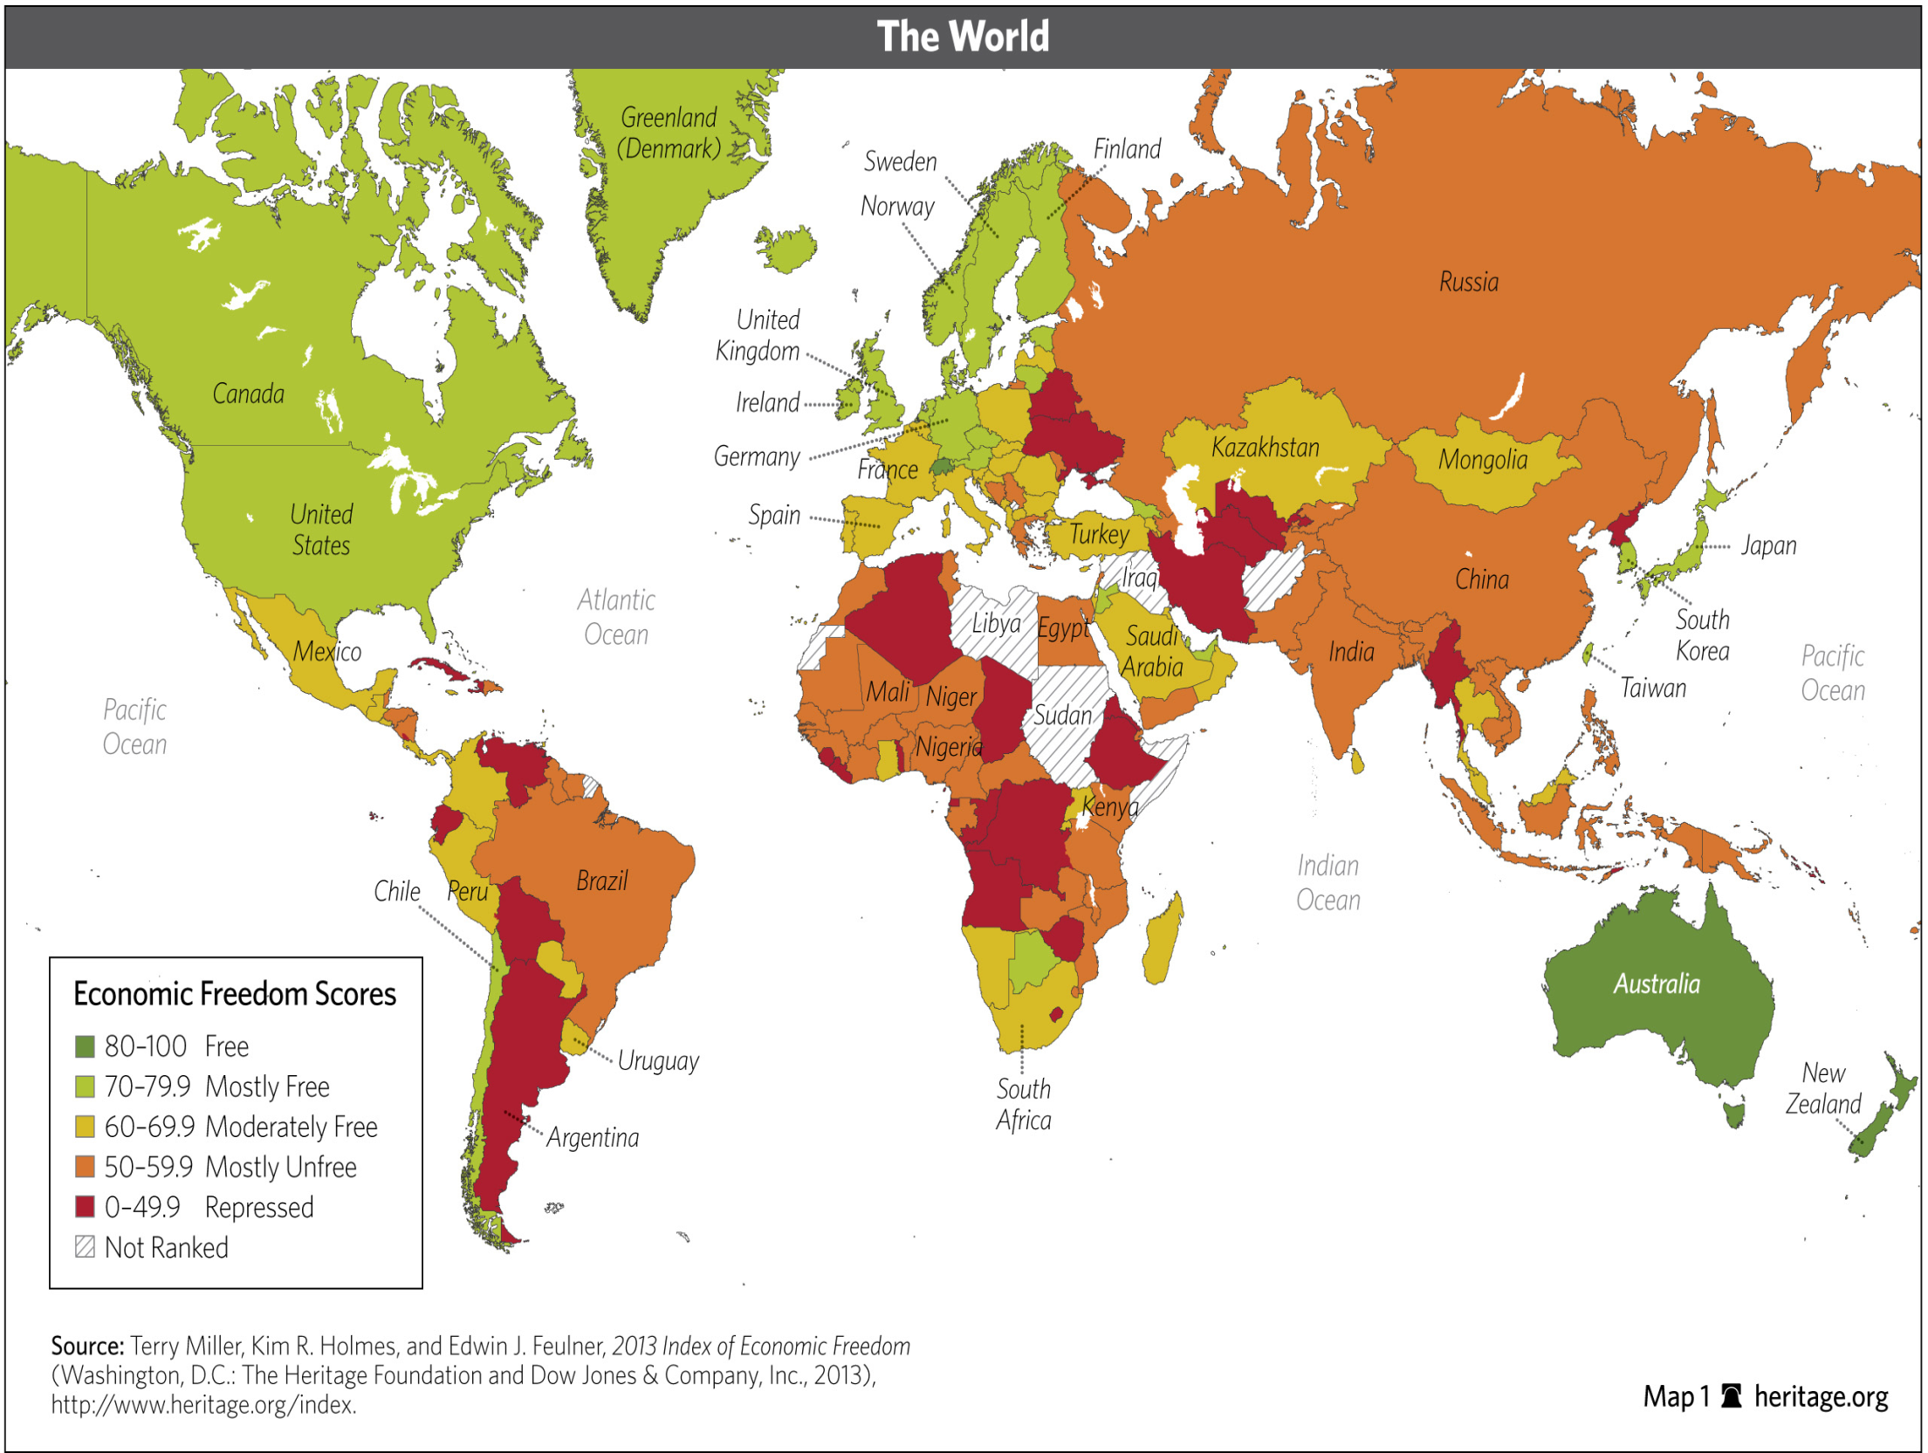

Slide 11

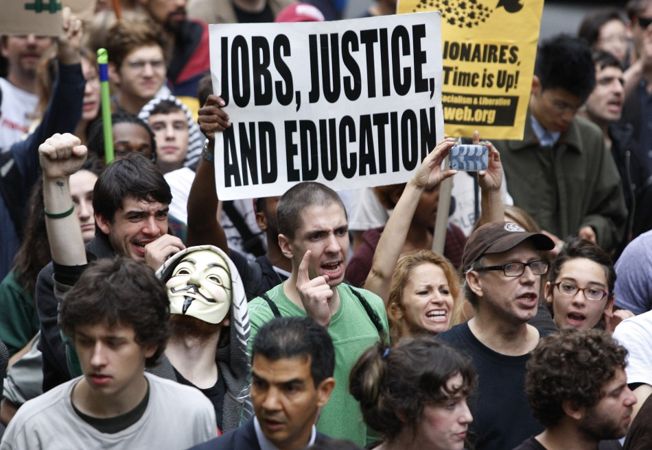

Marx’s Theory
Capitalism →
Class Struggle →
Worker’s Revolt → Socialism →
Communism

