Slide 1
States of Consciousness

Slide 2
What is Consciousness?
Consciousness has been defined by psychologists as our awareness of ourselves and our environment.
The awareness varies depending on our attention to the task at hand. Ex: driving.

Slide 3
Forms of Consciousness
Sensory awareness of the environment
Selective attention: focusing on a particular stimulus
Consciousness as direct inner awareness
Freud and the Unconscious
Dreams express unconscious wishes

Slide 4
Daydreams and Fantasies
Almost everyone daydreams at one point or another.
Young adults tend to fantasize more than older adults, and admit to more sexual fantasies.
Although 95% of all people have sexual fantasies, men tend to fantasize more than women.
Fantasy-prone personality: someone who imagines and recalls experiences with lifelike vividness and who spends considerable time fantasizing.

Slide 5
Why Might Daydreaming Be Helpful and Adaptive for Humans?
A way to escape
Prepare for future events
Aware of unfinished business
Increase creativity
Substitute for impulsive behavior

Slide 6
Sleep

Slide 7
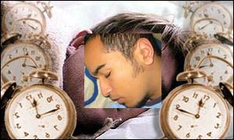
Biological Rhythms
Biological Rhythms: periodic physiological fluctuations built into human beings.
Ex: 28 day menstrual cycle, 24 hour alertness cycle, annual cycle, 90 minute sleep cycles.
Circadian Rhythm: biological clock that regulates body rhythms on a 24 hour cycle….larks vs. owls.

Slide 8
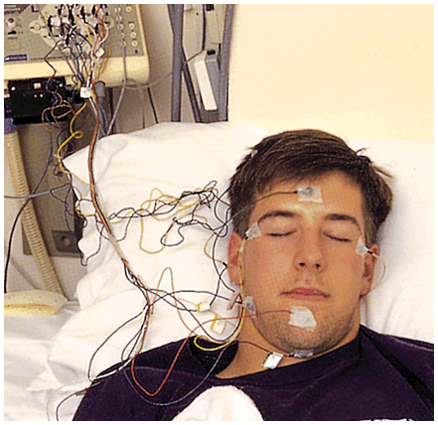
Sleep: refers to the periodic, natural, reversible loss of consciousness.
Using an EEG, sleep researchers have shown the mind is “awake” during various stages of sleep.

Slide 9
Sleep Stages: Stage 1
As we lay with our eyes closed we are in an awake but highly relaxed state characterized by alpha waves (slow waves) being emitted from our brain.
As we fall asleep, we have a 50% decrease in alpha wave activity…sometimes referred to as “drowsy sleep.”
During Stage 1 sleep, we often experience hallucinations: false sensory experiences. We may feel a sensation of falling or floating. Also have involuntary muscle movements.

Slide 10
Second Stage: Sleep Spindles
After about 5 minutes in stage 1 sleep, you slip into Stage 2 sleep which is characterized by Sleep Spindles: bursts of rapid, rhythmic, brain wave activity.
Stage where you are clearly asleep, sleep talking can occur in this stage or any other later stage.

Slide 11
Stage Three: Transition Stage
Stage Three begins your descent into “slow wave sleep.”
Delta Waves: (large, slow brain waves associated with deep sleep) begin appearing in stage 3 but are increasingly apparent in Stage 4.

Slide 12
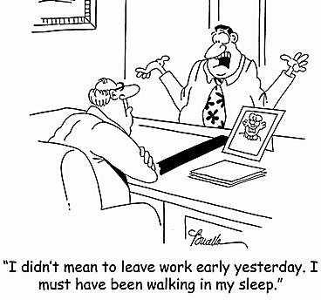
Stage Four: Delta Waves
Stage of deep sleep characterized by Delta Waves.
Stage when you are hard to awaken…but still aware of stimuli around you.
Stage at which sleepwalking or wetting the bed occurs.
Also experience night terrors.

Slide 13
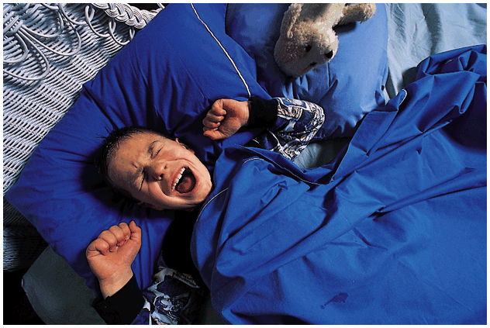
Night Terrors and Nightmares
Nightmares
Products of REM sleep
College Students: 2/month
Increase with stress and anxiety
Night Terrors
Occur during late stage 4 sleep and are characterized by high arousal and an appearance of terror but are seldom remembered.
Hearts race, gasp for air
Suddenly sit up, talk incoherently, or thrash
Most common in young children

Slide 14
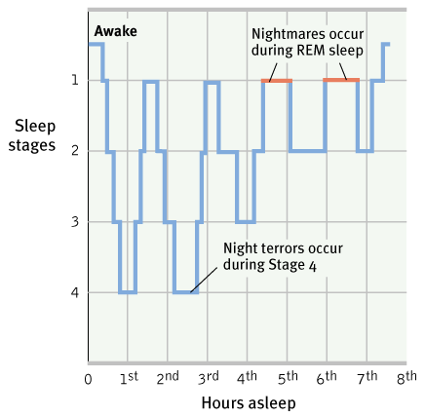
R.E.M. Sleep (Paradoxical Sleep)
After stage 4, your body cycles back to stage 3, stage 2, and into REM sleep.
A Normal Sleep cycle lasts about 90 minutes.

Slide 15
R.E.M. Sleep (Paradoxical Sleep)
R.E.M.: rapid eye movement sleep, stage where vivid dreams occur. Known as Paradoxical because muscles are relaxed yet body is highly active.
Heart rate increases, Breathing more rapid, eyes dart behind lids.
Genitals become aroused during R.E.M. sleep even when dreams are not sexual in nature.
As sleep cycle continues, R.E.M. sleep gets longer and longer.

Slide 16
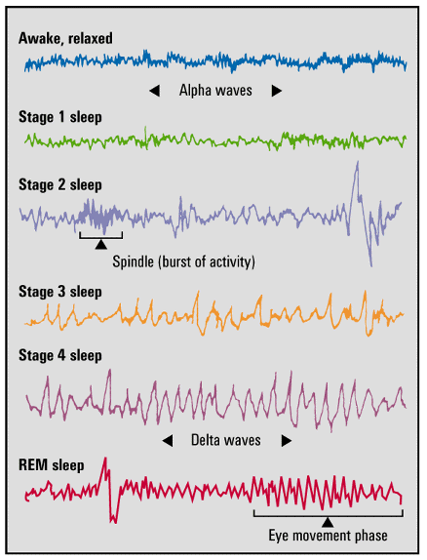
Brain Waves and Stages of Sleep

Slide 17
So Why Do We Sleep?
Most people will sleep for 9 hours if they could
Sleep debt
Decrease in work productivity
Increase in auto accidents
Suppressed immune system
Alter metabolic and hormonal functioning
Decrease in performance and creativity

Slide 18
Sleep Function
Theories:
1. Sleep protects
2. Helps us recuperate
3. Might help us grow

Slide 19
Sleep Disorders
Insomnia: inability to fall asleep or stay asleep.
10-15 % of adults
Sleeping pills and alcohol might make it worse
Less REM sleep

Slide 20
Sleep Disorders
Sleep Apnea: sleep disorder characterized by a temporary stoppage of breathing during sleep and consequent momentary awakenings.
Often complained about as “snoring.”
Often interrupts deep sleep stages leaving person feeling exhausted.

Slide 21
Tips for Sleeping
Relax before bed
Avoid caffeine
A glass of milk
Regular cycle
Exercise regularly, but not in the late evening

Slide 22
Dreams

Slide 23
What’s the Meaning Of Dreams?
Manifest Content: represents remembered story line of a dream.
Latent Content: represents underlying meaning of dreams dealing with wishes and drives.
Psychoanalytic Theorists like Freud will argue that dreams represent the royal road to the “unconscious.”
Dreams represent unresolved wishes/desires and discharge feelings that would be unacceptable if consciously voiced.

Slide 24
What’s The Meaning of Dreams? Depends Who You Ask?
Physiological Function of Dreams: periodic brain activity associated with R.E.M. sleep gives the brain needed activity to make neural connections. Also helps facilitate memory.
Activation-Synthesis Theory: dreams are result of brain’s attempt to make sense of random neural activity - mind always tries to make sense of stimuli.

Slide 25
What’s The Meaning Of Dreams? Depends Who You Ask!
Dreams As Part of Cognitive Development: all mammals experience R.E.M. sleep and many researchers believe it helps facilitate cognitive development.
R.E.M. Rebound: tendency for R.E.M. sleep to increase following deprivation - may illustrate a biological need for it.

Slide 26
Lucid Dreams
Lucid Dreams: are dreams in which you become aware that you are dreaming and you can control aspects of your environment in the dream.

Slide 27
What do we dream about?
Most dreams are about events in our daily lives
Previous day’s experiences

Slide 28
Have you ever dreamed of…..?
Falling 83%
Being attacked 77%
School,teacher, studying 71%
Arriving late 64%
Eating 62%
A loved person dying 57%
Being locked up 56%

Slide 29
Have you ever dreamed of…..?
Finding money 56%
Swimming 52%
Snakes 49%
Being inappropriately dressed 46%
Unable to breathe 44%
Fire 41%
Failing an Exam 39%
Killing Someone 26%

Slide 30
Hypnosis

Slide 31
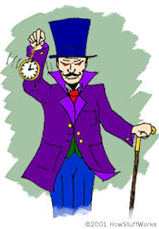
Hypnosis
Hypnosis- a social interaction in which one person ( the hypnotist) suggests to another ( the subject) that certain perceptions, feelings, thoughts or behaviors will occur

Slide 32
Can anyone Experience Hypnosis?
It depends on the subject’s openness to suggestion

Slide 33
Can Hypnosis Enhance Recall of Forgotten Events?
Hypnosis does not help us recover “accurate memories as far back as birth”
Highly hypnotizable people are especially vulnerable to false memory suggestions

Slide 34
Can hypnosis force people to act against their will?
An authoritative person in a legitimate context can induce people- hypnotized or not- to perform some unlikely acts

Slide 35
Can Hypnosis Alleviate Pain?
YES
10% of us can become so deeply hypnotized that even major surgery can be performed without anesthesia
Dissociation- a split between levels of consciousness.
Dissociate the sensation of the pain from the emotional suffering
Selective Attention

Slide 36
Is Hypnosis an Altered State of Consciousness?
Hypnosis as a social phenomenon
Behaviors produced through hypnotic procedures can also be produced without them
People do what is expected of them

Slide 37
Is Hypnosis an Altered State of Consciousness?
Hypnosis As A Divided Consciousness
Explains hypnosis not as a unique “trance state” where the “subconscious” is under control by the hypnotist but rather as a split in awareness caused by the “subjective experience of hypnosis.”

Slide 38
Perspectives On Dissociation

Slide 39
Hypnosis Concepts: Can Hypnosis Have an Effect After The Session?
Posthypnotic Amnesia: supposed inability to recall what one experienced during hypnosis; induced by the hypnotist’s suggestion. “You will no longer remember anything you experienced today.”
Posthypnotic Suggestion: a suggestion made during a hypnosis session that will be carried out after hypnosis session is over. “You will no longer feel the need to smoke after this session is over.”

Slide 40
Near Death Experiences

Slide 41
Near Death Experiences
Near Death Experiences: an altered state of consciousness reported after a close brush with death.

Slide 42
Dualism
Dualism: argues that the mind and body are two distinct entities that interact. The “mind” is nonphysical and can exist apart from the physical body.
Was put forth by many philosophers including Renee Descartes and Socrates.

Slide 43
Monism (Materialism)
Monism argues that the mind and body are different aspects of the same thing.
Mind and body cannot be separated without bodies we are nobodies.
Thomas Hobbes along with many philosophers and scientists support this viewpoint.

Slide 44
How Would Dualists vs. Monists explain “Near Death Experiences?”

