Slide 1
Early Explorers

Slide 2
Why did Explorers leave Europe?
Sea routes for spice trade
Find natural resources
Expand kingdom and more land
Expand knowledge and religion

Slide 3
Who were the major explorers?
Christopher Columbus
Amerigo Vespucci
Ferdinand Magellan
Hernando Cortes

Slide 4
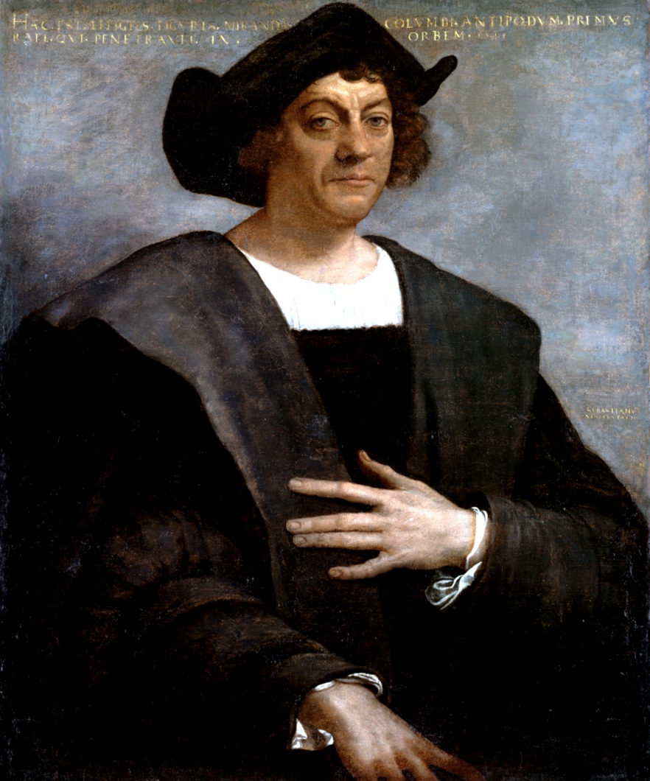
Columbus 1492-1493
Wanted to find new trade routes to Asia
Landed in the Caribbean
New areas of land were known as the “New World”

Slide 5
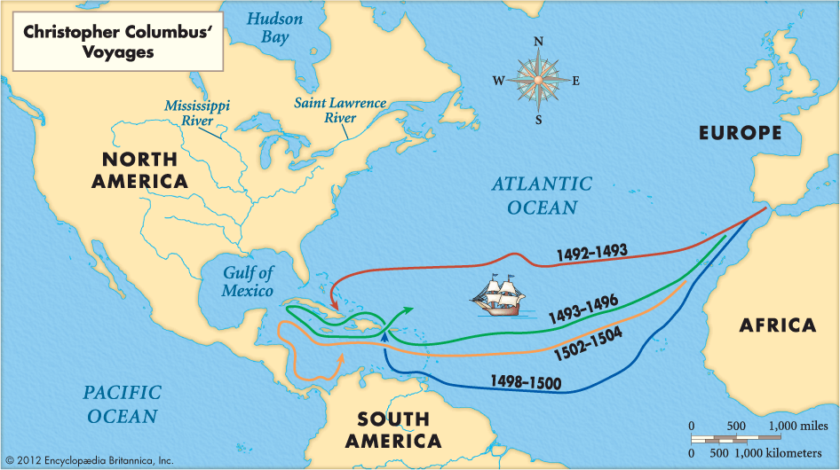
Columbus, Cont.
Came back in 1493 with more ships and people
Found gold and it was on!
Spain began to colonize the New World
Still thought they were in Asia

Slide 6
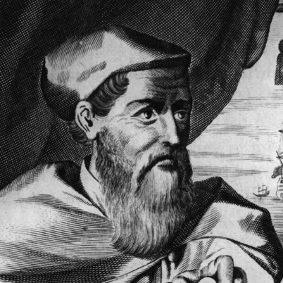
Amerigo vespucci 1499
Italian
Tried to find a new way to India
1st trip- thought he was in Asia
2nd Trip- realized it was not Asia and named the new continent “the Americas”

Slide 7
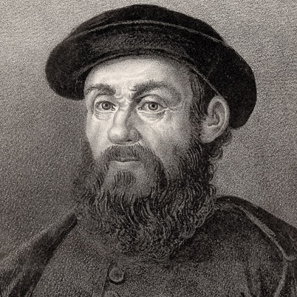
Ferdinand Magellan 1519-1522
Portuguese
Wanted to find a way to the Pacific via the Atlantic
Went around the tip of South America
Got killed in civil war in Philippines
Crew finished the trip and were the first to go completely around the world.

Slide 8
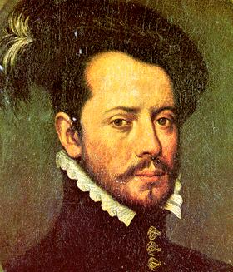
Hernando Cortes 1519-1521
Member of the Spanish colony in Cuba
Heard that the Mayans in Mexico had gold
Conquered the Aztecs in Mexico and claimed the land for Spain

