Slide 1
End of WWII

Slide 2
End of WWII in Europe
Battle of the Bulge
Germany begins to retreat
Battle of Berlin
Final major offensive in Europe
Soviet Union encircle Berlin
April 27th, 1945
Mussolini is executed and hung in the city on display
April 30th, 1945
Hitler commits suicide with his partner Eva Braun

Slide 3
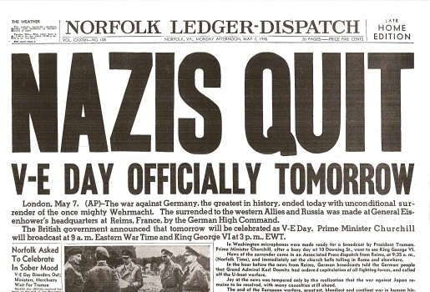
Germany Surrenders
May 2nd- Germany Surrenders in Berlin
May 7th- Germany surrenders all forces to the Allies
May 8th- V-E Day
Victory in Europe
War in Europe is over

Slide 4
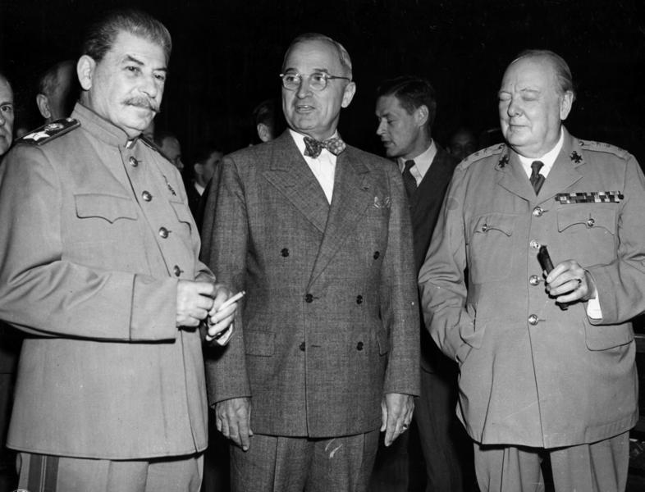
Potsdam Agreement
Aug. 1945- Germany signed agreement with U.S., U.S.S.R., Great Britain, and France
Allies will control Germany
Germany split into four sections
Paris Peace Conference- Peace in Europe is established (Feb. 10 ,1947)

Slide 5
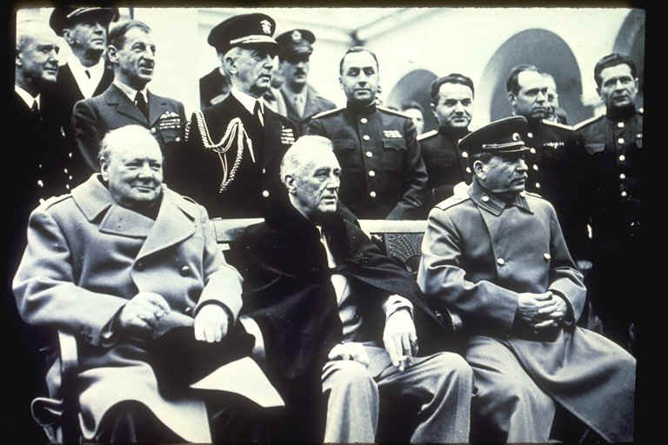
End of the War in Asia
Feb. 4, 1945
Yalta Conference
U.S.S.R. will invade Japan within 3 months of German surrender
July- Allies call on Japan to surrender
Soviet Union invades China and defeats Japan in Manchuria

Slide 6
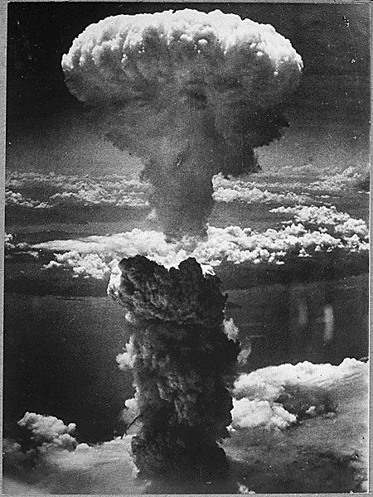
Atomic Bombs
Aug. 6th, 1945
Enola Gay drops first atomic bomb on Hiroshima, Japan
Aug. 9th, 1945
2nd bomb is dropped on Nagasaki
Approximately 200,000 people die as a direct result
Aug. 14th- Japan surrenders, V-J Day

Slide 7
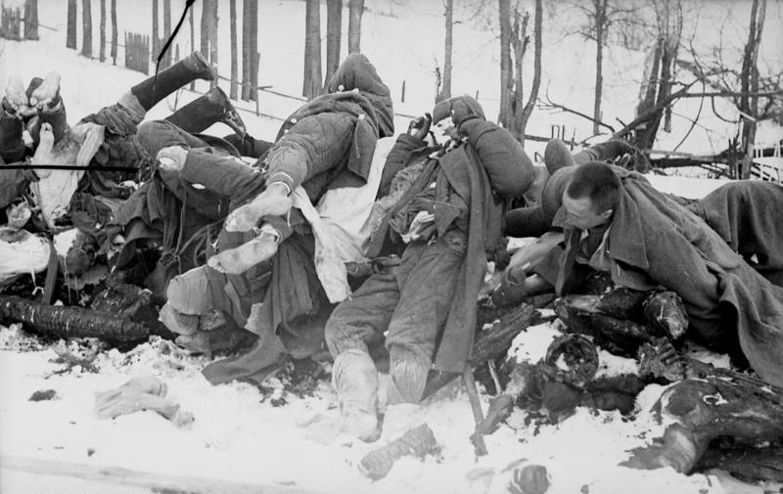
Death Tolls
Total Deaths= 50-80 million
France= 550,000
Germany= 9 million
Italy= 454,6000
Poland= 5 million
Soviet Union= app. 25 million
Japan= 3 million
U.S.= 418,000

