Slide 1
European Imperialism in Africa

Slide 2
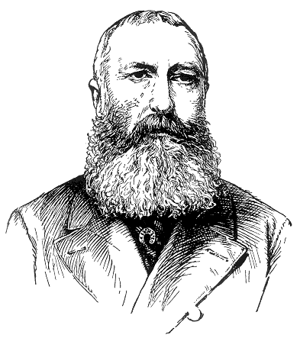
Where did it all begin?
New World colonies and settlements were gaining independence
1870’s- King Leopold of Belgium sent merchants to the Congo to establish trade
It was on from there!

Slide 3
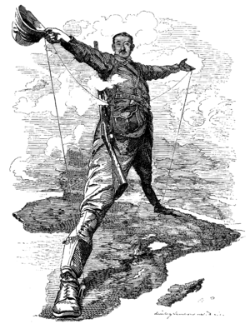
The Scramble for Africa
1450-1750
Traded, but few colonies (mainly along the coast)
Missionaries began exploring
Began establishing trading posts and colonies

Slide 4
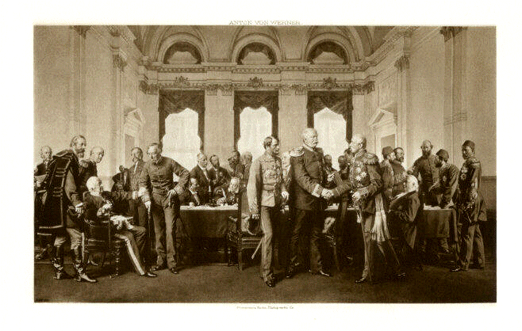
Berlin Conference 1884-5
European diplomats met to draw boundaries for European controlled colonies
No African leaders were present
Almost all parts of Africa were colonized by 1900

Slide 5
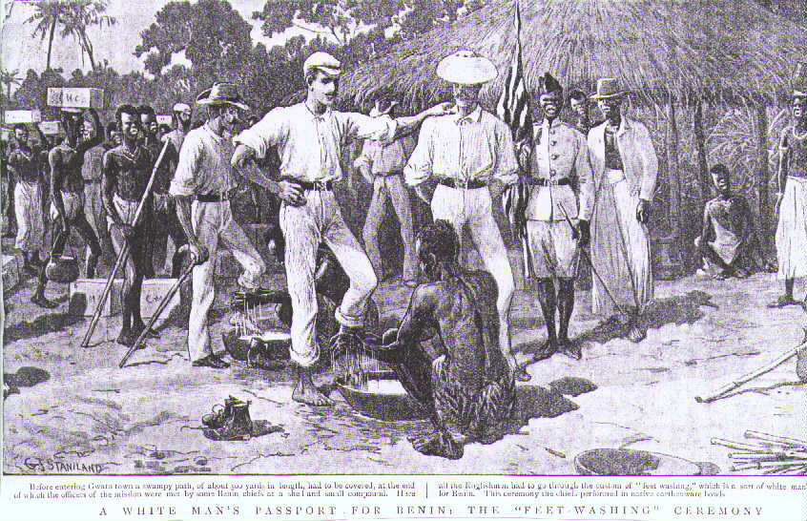
Causes of African Imperialism
White Man’s Burden
Native cultures are inferior to Western cultures
Natural Resources
Cheap Materials
Abundance
Low Competition
Very Profitable

Slide 6
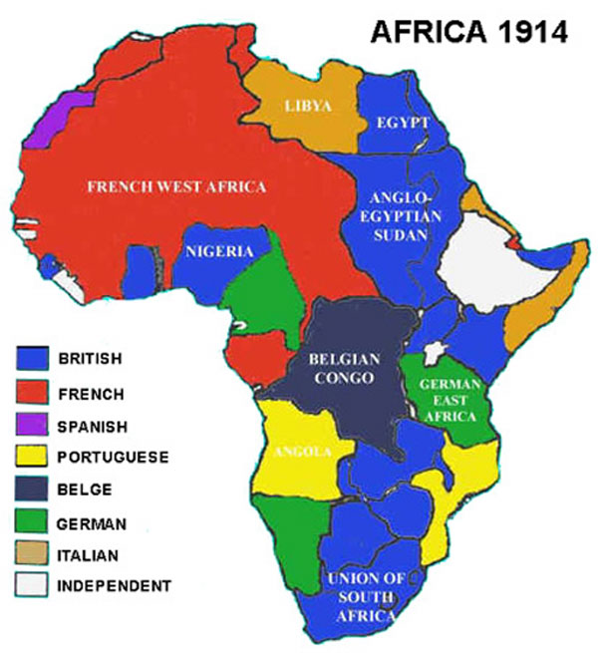
Where did they colonize?

