Slide 1
Hormones and Behavior

Slide 2
What are hormones?
Stimulate growth and reactions
Reactions may include
Activity level
Mood
Travel through the body to receptor sites

Slide 3
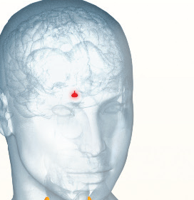
Pituitary Gland
“the master gland”
Stimulates other glands
Human growth hormone
Prolactin – production of milk
Oxytocin – stimulates labor

Slide 4
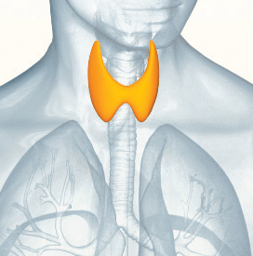
Thyroid Gland
Produces thyroxin
Thyroxin = metabolism
Too little thyroxin = sluggish and overweight
Too much thyroxin = weight loss, excitability, insomnia

Slide 5
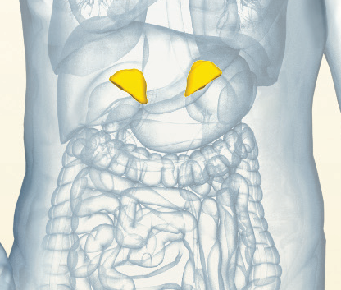
Adrenal Glands
Produce cortical steroids
Increase resistance to stress
Promote muscle development
Produce adrenaline
Stressful situation → nervous system→ adrenal gland → release of adrenaline → cope with stress

Slide 6
Ovaries and Testes
Sexual development
Both produce estrogen, progesterone, and testosterone
Estrogen and Progesterone
Testosterone
High levels in females
Menstrual cycle
PMS
Menopause
Optimal cognitive functioning
Feelings of well-being
High levels in males
Develops sex characteristics (beards)
Steroid – muscle mass, less stress, energy supply

