Slide 1
Memory
Memory is a way of holding onto the things you love, the things you are, the things you never want to lose.
- From the television show The Wonder Years

Slide 2
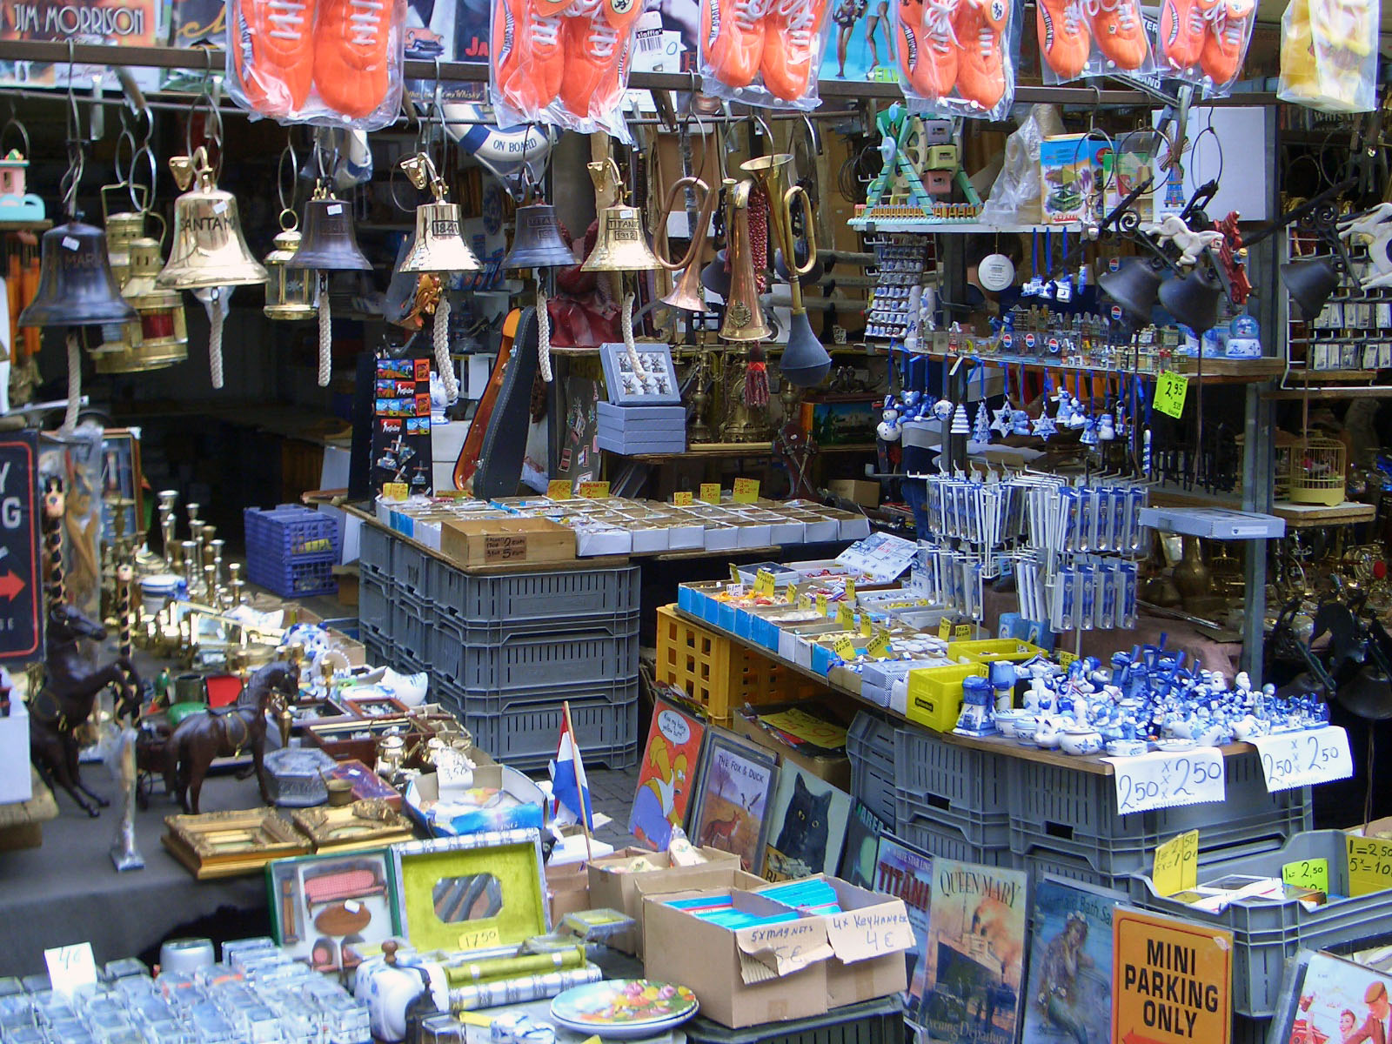

Slide 3
Three Basic Types of Memory
Episodic
  Memory of specific events
Semantic Memory
  Memory of words or facts
Implicit Memory
  Implied memories
  Practiced Skills and learned habits

Slide 4
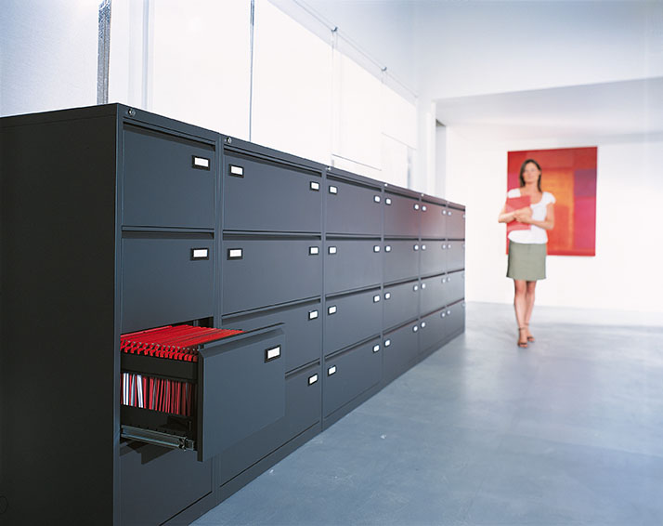
Three Basic Processes of Memory
Encoding
  Translating sensory information
  Visual
  Acoustic
  Semantic
Storage
  Achieved through rehearsal
    Maintenance
    Elaborative
Retrieval
  Context-dependent
    Location/situation
  State-dependent
    Emotional state

Slide 5
Three Stages of Memory
Sensory Memory
  Initial stage
Short-Term Memory
  Working memory
  Whatever you are thinking about
Long-Term Memory
  Is constantly being built
  Your 2nd grade classroom
  Your room when you were 7

Slide 6
Short-Term Memory
Short-Term Memory
Short-Term Memory

Slide 7
Long-Term Memory
Long-Term Memory

Slide 8
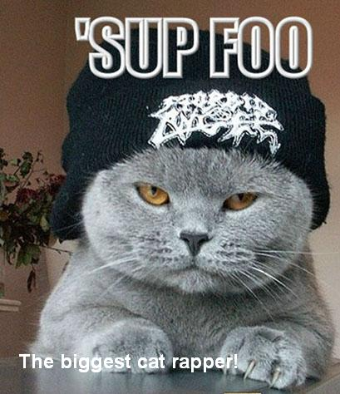
Ways to Improve Memory
Drill and Practice
Relate to Existing Knowledge
Form Unusual Associations (Cats & Rap Music)
Use Mnemonic
Devices
Don’t Cram
Sleep Well
Listen to Music

Slide 9
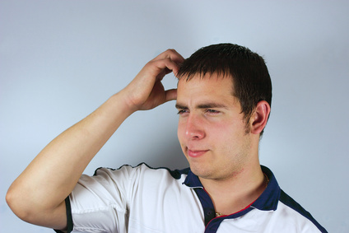
Factors that Interfere with Memory
Unhealthy eating habits
Dehydration
Lack of physical activity
Drug use
Age
Smoking

Slide 10
Forgetting
Short-Term: 10 – 12 seconds if not used
Long-Term: Lasts forever as long as overcrowding and interference don’t occur.
Decay
Repression
Amnesia
Infantile Amnesia

