Slide 1
Sensation and Perception

Slide 2
Sensation is…
The stimulation of sensory receptors and the transmission of sensory information to the central nervous system

Slide 3
Perception
The psychological process through which we interpret sensory stimulation
Reflects learning, expectations and attitudes

Slide 4
Absolute Threshold
The weakest amount of stimulus that can be sensed.
Vision – candle flame 30 miles away in the dark
Hearing – ticking of a watch 20 feet away in a dark room
Smell – one drop of perfume diffused in a house
Taste – 1 teaspoon of sugar dissolved in 2 gallons of water
Touch – wing of a fly falling on a cheek from a distance of less than a half an inch

Slide 5
Difference Threshold
The minimum amount of difference that can be detected between two stimuli.

Slide 7
Sensory Adaptation
More sensitive to weak stimuli and less to unchanging stimuli
Ex. Humming of heater
Pencil tapping

Slide 8
Signal-Detection Theory
Method of distinguishing sensory stimuli that takes into account the strength of the stimuli but also the variable elements (setting, physical state, mood, attitudes)

Slide 9
Visual Sensations

Slide 10
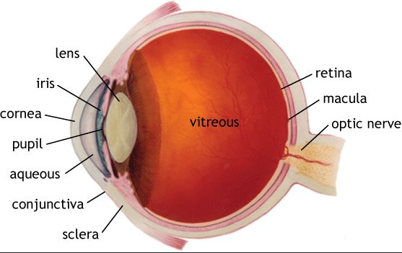
The Eye

Slide 11
Photoreceptors
Located in the retina
Rods
Long and skinny
Sensitive to brightness
Black and white
Cones
Less sensitive to light
Color
Only detect red, blue, and green

Slide 12
Colorblindness
Absence or malfunctions of cones
Partial colorblindness is common
Red-green are hardest
Males are more likely than females
8% of males

Slide 13
Hearing

Slide 14
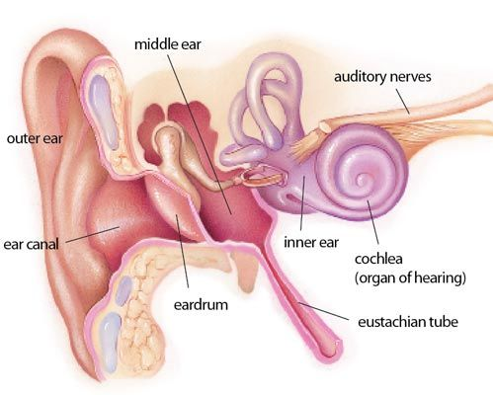
The Ear

Slide 15
Decibels
Measure of loudness
Constant 85 dB can cause hearing loss over time
Average car- 80 dB
130 dB+= immediate
Concert- 120 dB
Ambulance siren- 120 dB
Firecracker- 150 dB
Average ear buds for teens? 110-120 dB

Slide 16
Anatomy
Cochlea
Filled with fluid and neurons
Responds to vibrations
Auditory nerve
Transmits messages to the brain

