Slide 1
THALAMUS
AP PSYCHOLOGY
UNIT 3 B

Slide 2
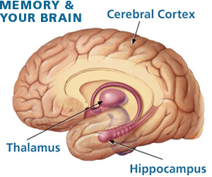

Slide 3
Major Functions
Motor Control
Receives Auditory, Somatosensory, & Visual Sensory Signals.
Controls asleep and awake states
Relays Sensory Signals to Cerebral Cortex

Slide 4
Behavior Controls
Thalamus deals with
Eye Sight Watching T.V.
Hearing Listening to Music
Touch Knowing when stove is too hot
Tasting Eating your favorite food

Slide 5
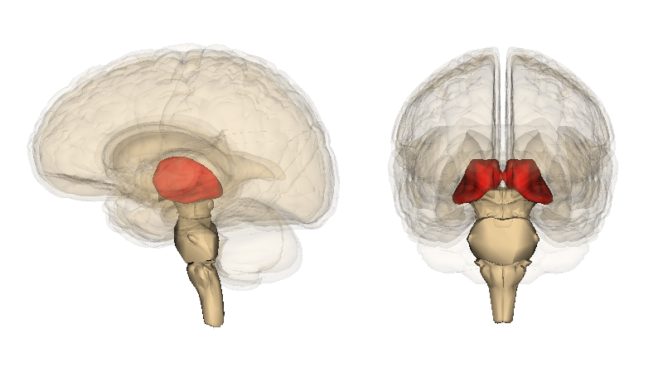
Independent or Connected with other parts if brain?
A Nuclear complex Structure of 4 Parts.
Mainly connected to the
hippocampus via the
mammillo-thalamic tract.

Slide 6
How it Works?

Slide 7
Origin
“Thalamos” – inner room or storage room
Optic Nerve
Argue over Sensory or Motor nerve?

Slide 8
Modern Physiology
In 1889, Thalamic Nucleis were discovered
Microelectrode Technique
Both Sensory and Motor Pathways

Slide 9
Injury on Thalamus
Damage to all senses
Touch (feel) and Vision (eye sight)
Loss of Hearing and Loss of Speech

Slide 10
Current Research
The treatment of “Thalamic Syndrome”.
Pain Strokes
All senses becomes oversensitive.

