Slide 1
Trench Warfare

Slide 2
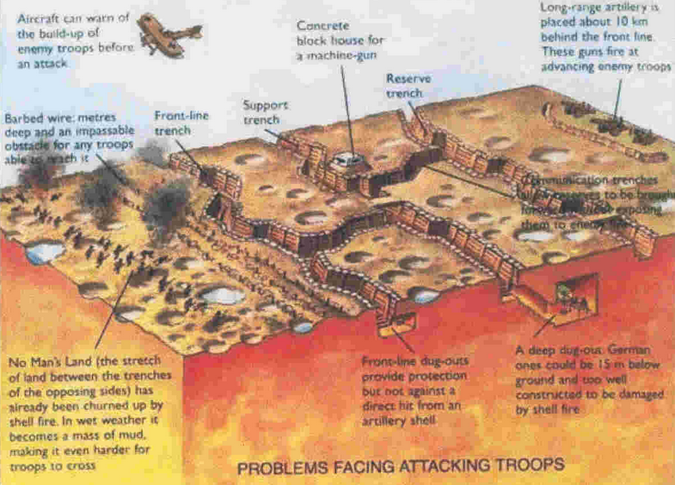
Trench Diagram

Slide 3
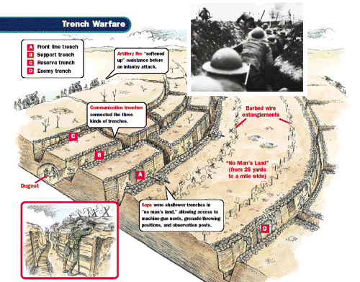
Trench Diagram

Slide 4
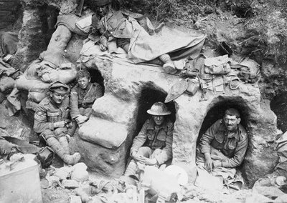
Life in the Trenches

Slide 5
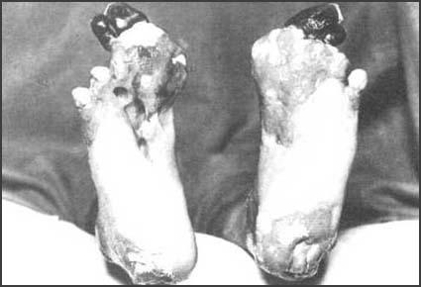
Trench Foot

Slide 6
Activity
Read through the “Memories from the Trenches” link on Weebly.
After reading these diary entries, pretend that you are a soldier fighting in the trenches. Write a letter home to a loved one explaining what life is like and what hardships you are facing.

