Slide 1
WWI

Slide 2
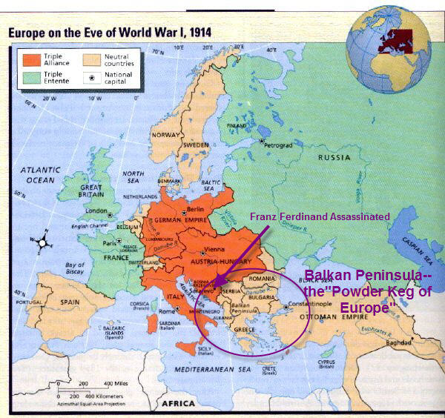
How it all began…
“Powder Keg” in the Balkans
  June 28. 1914
  Archduke Franz Ferdinand is assassinated by Serbian national
Austria/Hungary declares war on Serbia
Russia backs Serbia
Germany declares war on Russia and France
France enters the war

Slide 3
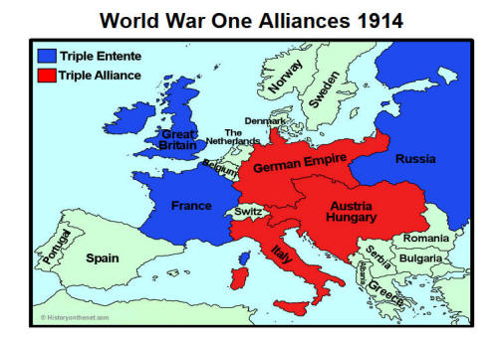
Two sides go to war
Triple Alliance
  Germany
  Austria-Hungary
  The Ottoman Empire
Triple Entente
  Great Britain
  France
  Russia

Slide 4
Causes of the War
Nationalism
  Congress of Vienna split up Italy and Germany
  Other countries were combined and had rival groups in the same area
Imperialism
  Britain and France had many colonies with several resources
  Germany joined late in the game and had a small portion of Africa
Militarism
  Arms race was on between many countries
  Almost all countries wanted to bolster their armed forces to protect themselves and be the dominate country in the region
Alliances

Slide 5
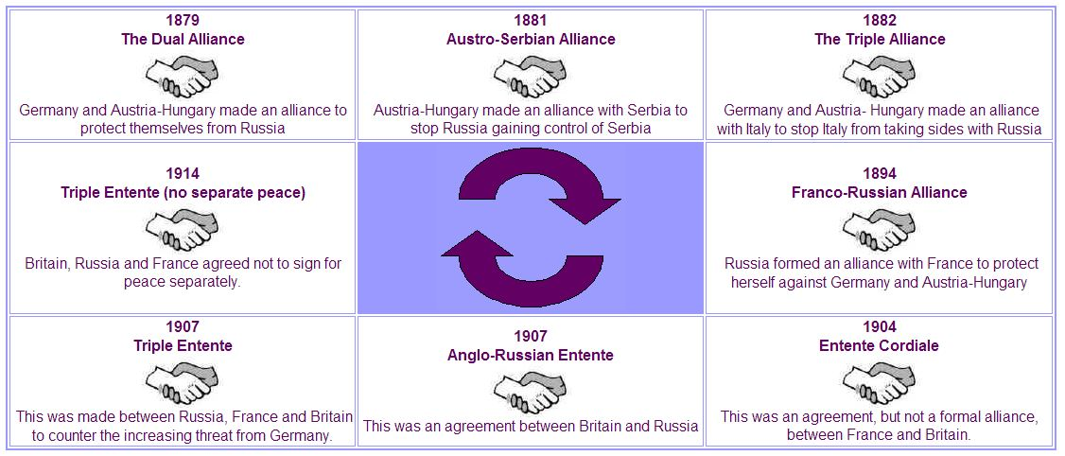
Alliances

Slide 6
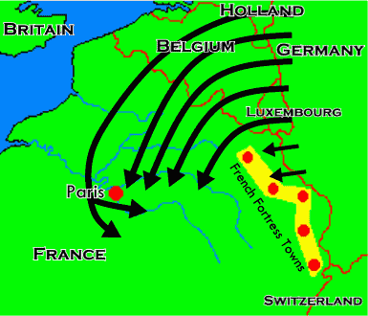
Schlieffen plan
Germany’s idea to attack France fast to then focus attention on Russia
Aborted just one month into the war
  Early Russian attack
  France fought back

Slide 7
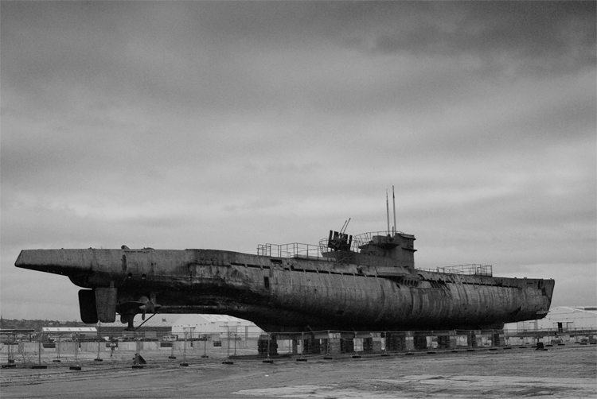
War at sea
German U-boats
  Torpedoes
Unrestricted submarine warfare

Slide 8
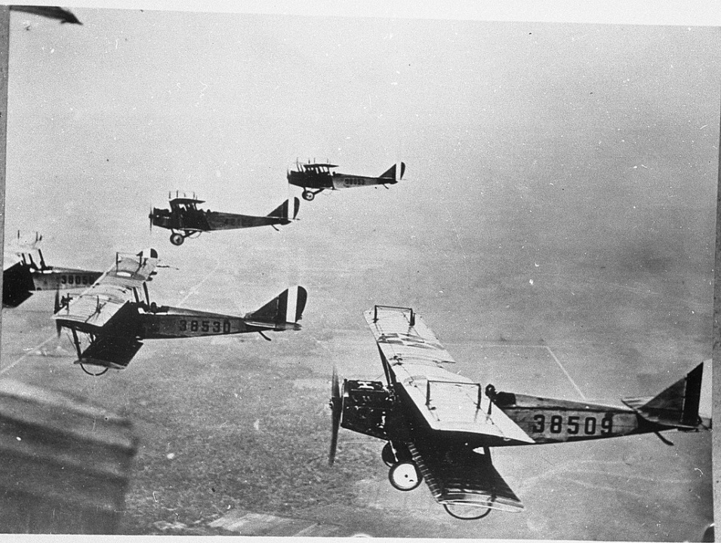
War in the air
Spying
  Reconnaissance Planes
Fighter Jets
  On board machine guns
  Stop reconnaissance planes
Bombers
Zepplins
  German slow moving bombers

Slide 9
War of attrition
Italy
  Neutral, then joined Triple Alliance
Battle of Verdun
  Stalemate in 1916
  German Offensive toward France
  650,000 soldiers died in ten months
Battle of the Somme
  Entente Offensive
  4.5 months 164,000 soldiers died
War of Attrition- who could lose the most in battle

Slide 10
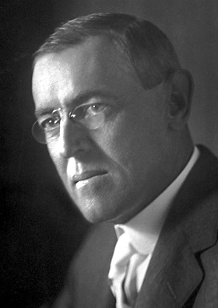
U.S. Neutrality
U.S. tried to remain neutral in the war
Woodrow Wilson (President of U.S.) and the Progressive Movement
  Bring democracy to the world
Public Opinion- stay out of the war

Slide 11
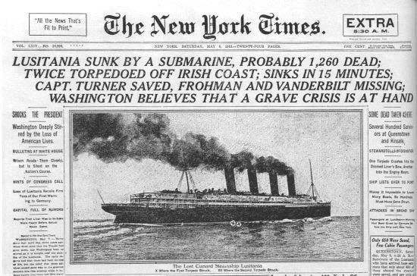
Sinking of the Lusitania
British passenger ship that left New York for Britain
Cruiser Rules
  International Law- can’t fire on them
German U-boats fired on them
Sunk the ship, killing 1,195 people (128 Americans)
Germany justified the attack
  Weapons of War on board

Slide 12
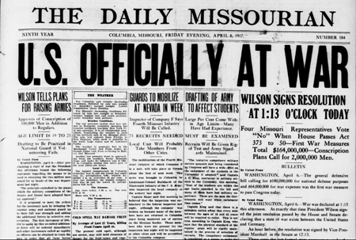
U.S. Enters the war
Zimmerman Note
  German Foreign Minister invited Mexico to ally with Germany
  U.S. intercepted the message and got angry with Germany
U.S. joins the war with the Entente
  They accepted them with open arms
    They couldn’t replace their dead fast enough, now they could
  Final push needed to defeat the Triple Alliance members

