Slide 1
WWII

Slide 2
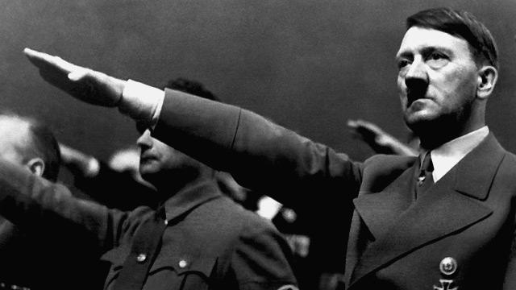
Rise of Hitler
Tries to take over Germany through a coup in 1928- fails
Tries to become President in 1932- fails
Becomes Chancellor in 1932 and quickly takes over the government
Invalidates the Treaty of Versailles in 1935

Slide 3
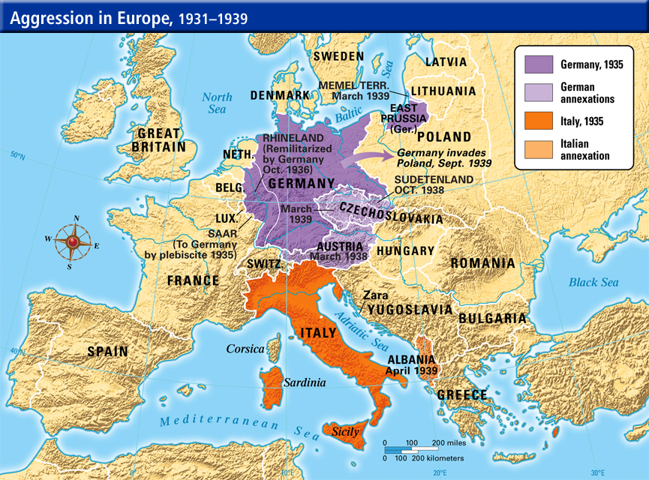
German Aggression
1938- Germany Takes over Czechoslovakia
Sept. 1939- Germany invades Poland
Sept. 1939- USSR helps Germany and invades Poland from the East
Sept. 1939- Poland falls to Axis control

Slide 4
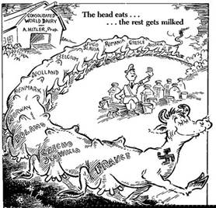
Europe Responds
Appeasement
  No money or resources to fight
  Don’t want to get involved
  Give them what they want to make them stop
By Sept. 1939- Britain and France declare war on Germany

Slide 5
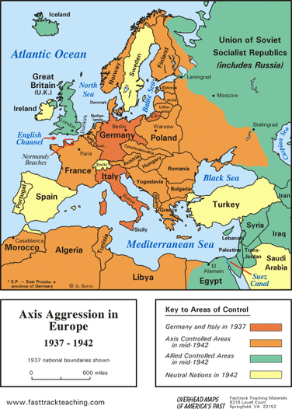
Sides of the War Develop
Axis
  Germany
  Italy
  USSR
  Japan
Allies
  Great Britain
  France
  United States
  USSR

Slide 6
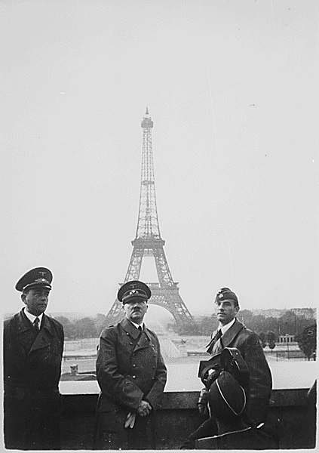
Germany Takes Paris
May 1940 Germany enters and conquers Belgium
June 1940- Germany invades France
  Captures Paris
  France surrenders
  Revenge for Germany after WWI

Slide 7
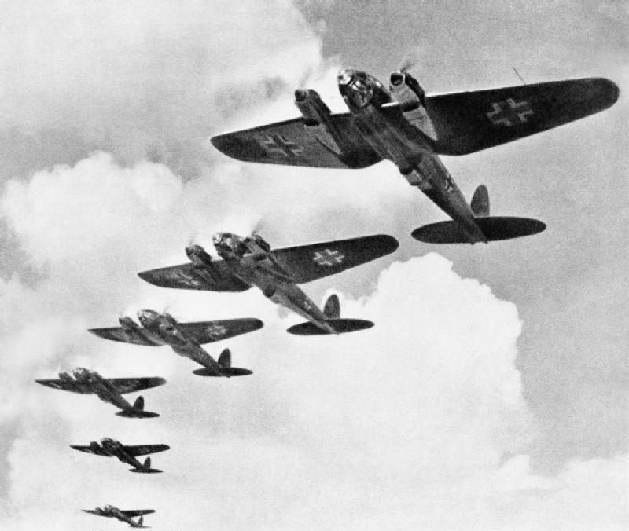
Battle of Britain (July 1940)
3 month long bombing campaign by Germany
Much of Britain, particularly London, will be destroyed
By Sept. 1940- Germany realizes they can’t win and move their attention to the Soviet Union.

Slide 8
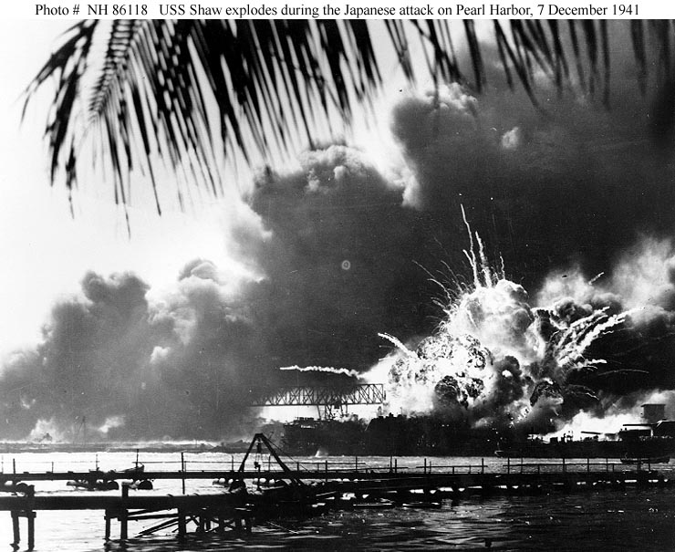
U.S. Enters the War
Lend-Lease Act (March 1941)
  U.S. can sell weapons to people who will protect U.S.
Atlantic Charter (Aug. 1941)
  U.S. will help defeat the Nazis
Pearl Harbor (Dec. 7, 1941)
  Japan launches attack on Pearl Harbor
U.S declares war on Japan
  Germany and Italy declare on U.S.

Slide 9
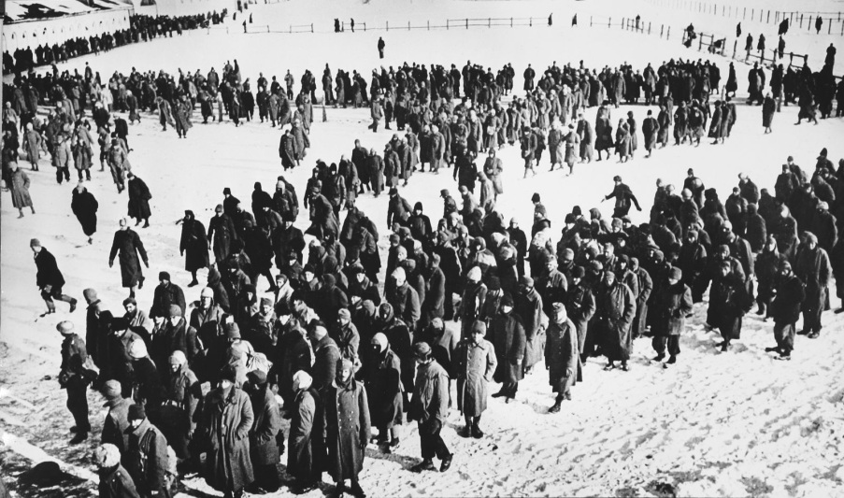
Stalingrad (Aug. 1942)
Germany had been attaching the U.S.S.R.
Began their attack on Stalingrad (6 month battle)
Red Army (USSR) defeats Nazis
Over 2 million people (soldiers and civilians) die
Turning point in the European war

Slide 10
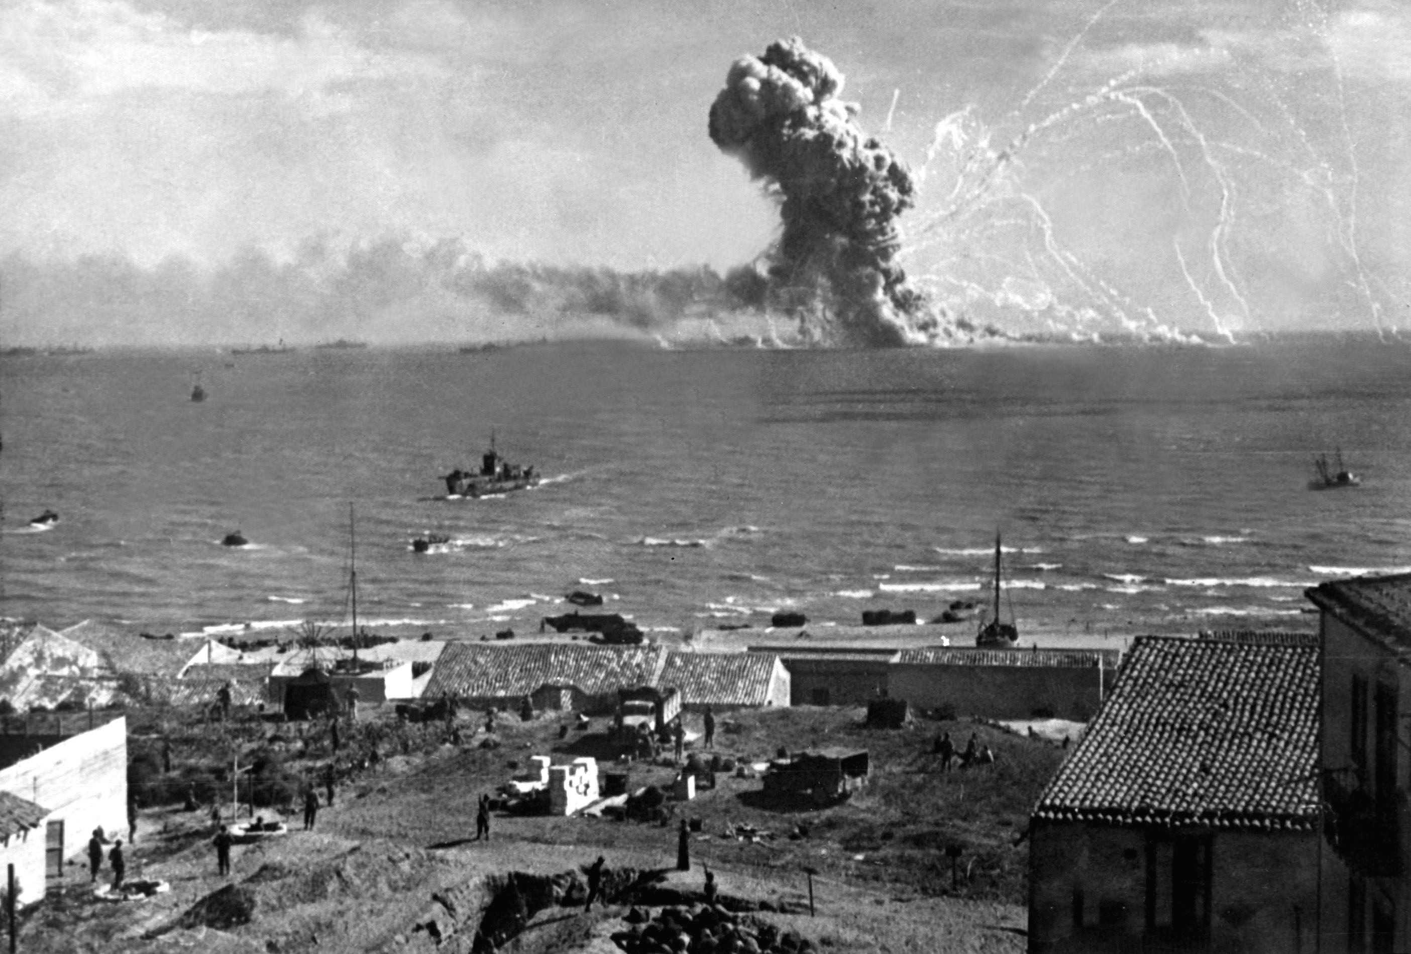
Italy is Defeated
Allied forces move through North Africa
Began to close in on Italy
By Sep. 1943, Allies capture major cities in Italy
Mussolini is overthrown and imprisoned
Began to invade though Italy

Slide 11
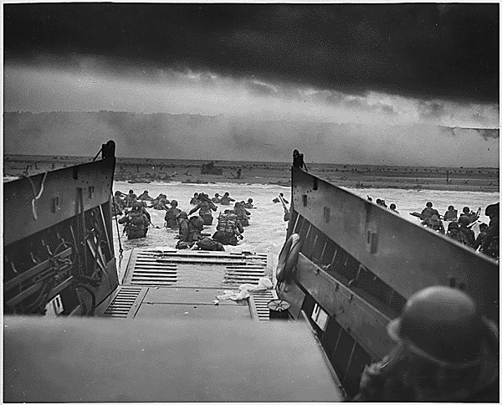
D-Day (June 1944)
Allies want to win back France
Operation Overlord
Over 160,000 troops land on the beaches of Normandy, France
By Aug. 1944, France is liberated by Allied troops

Slide 12
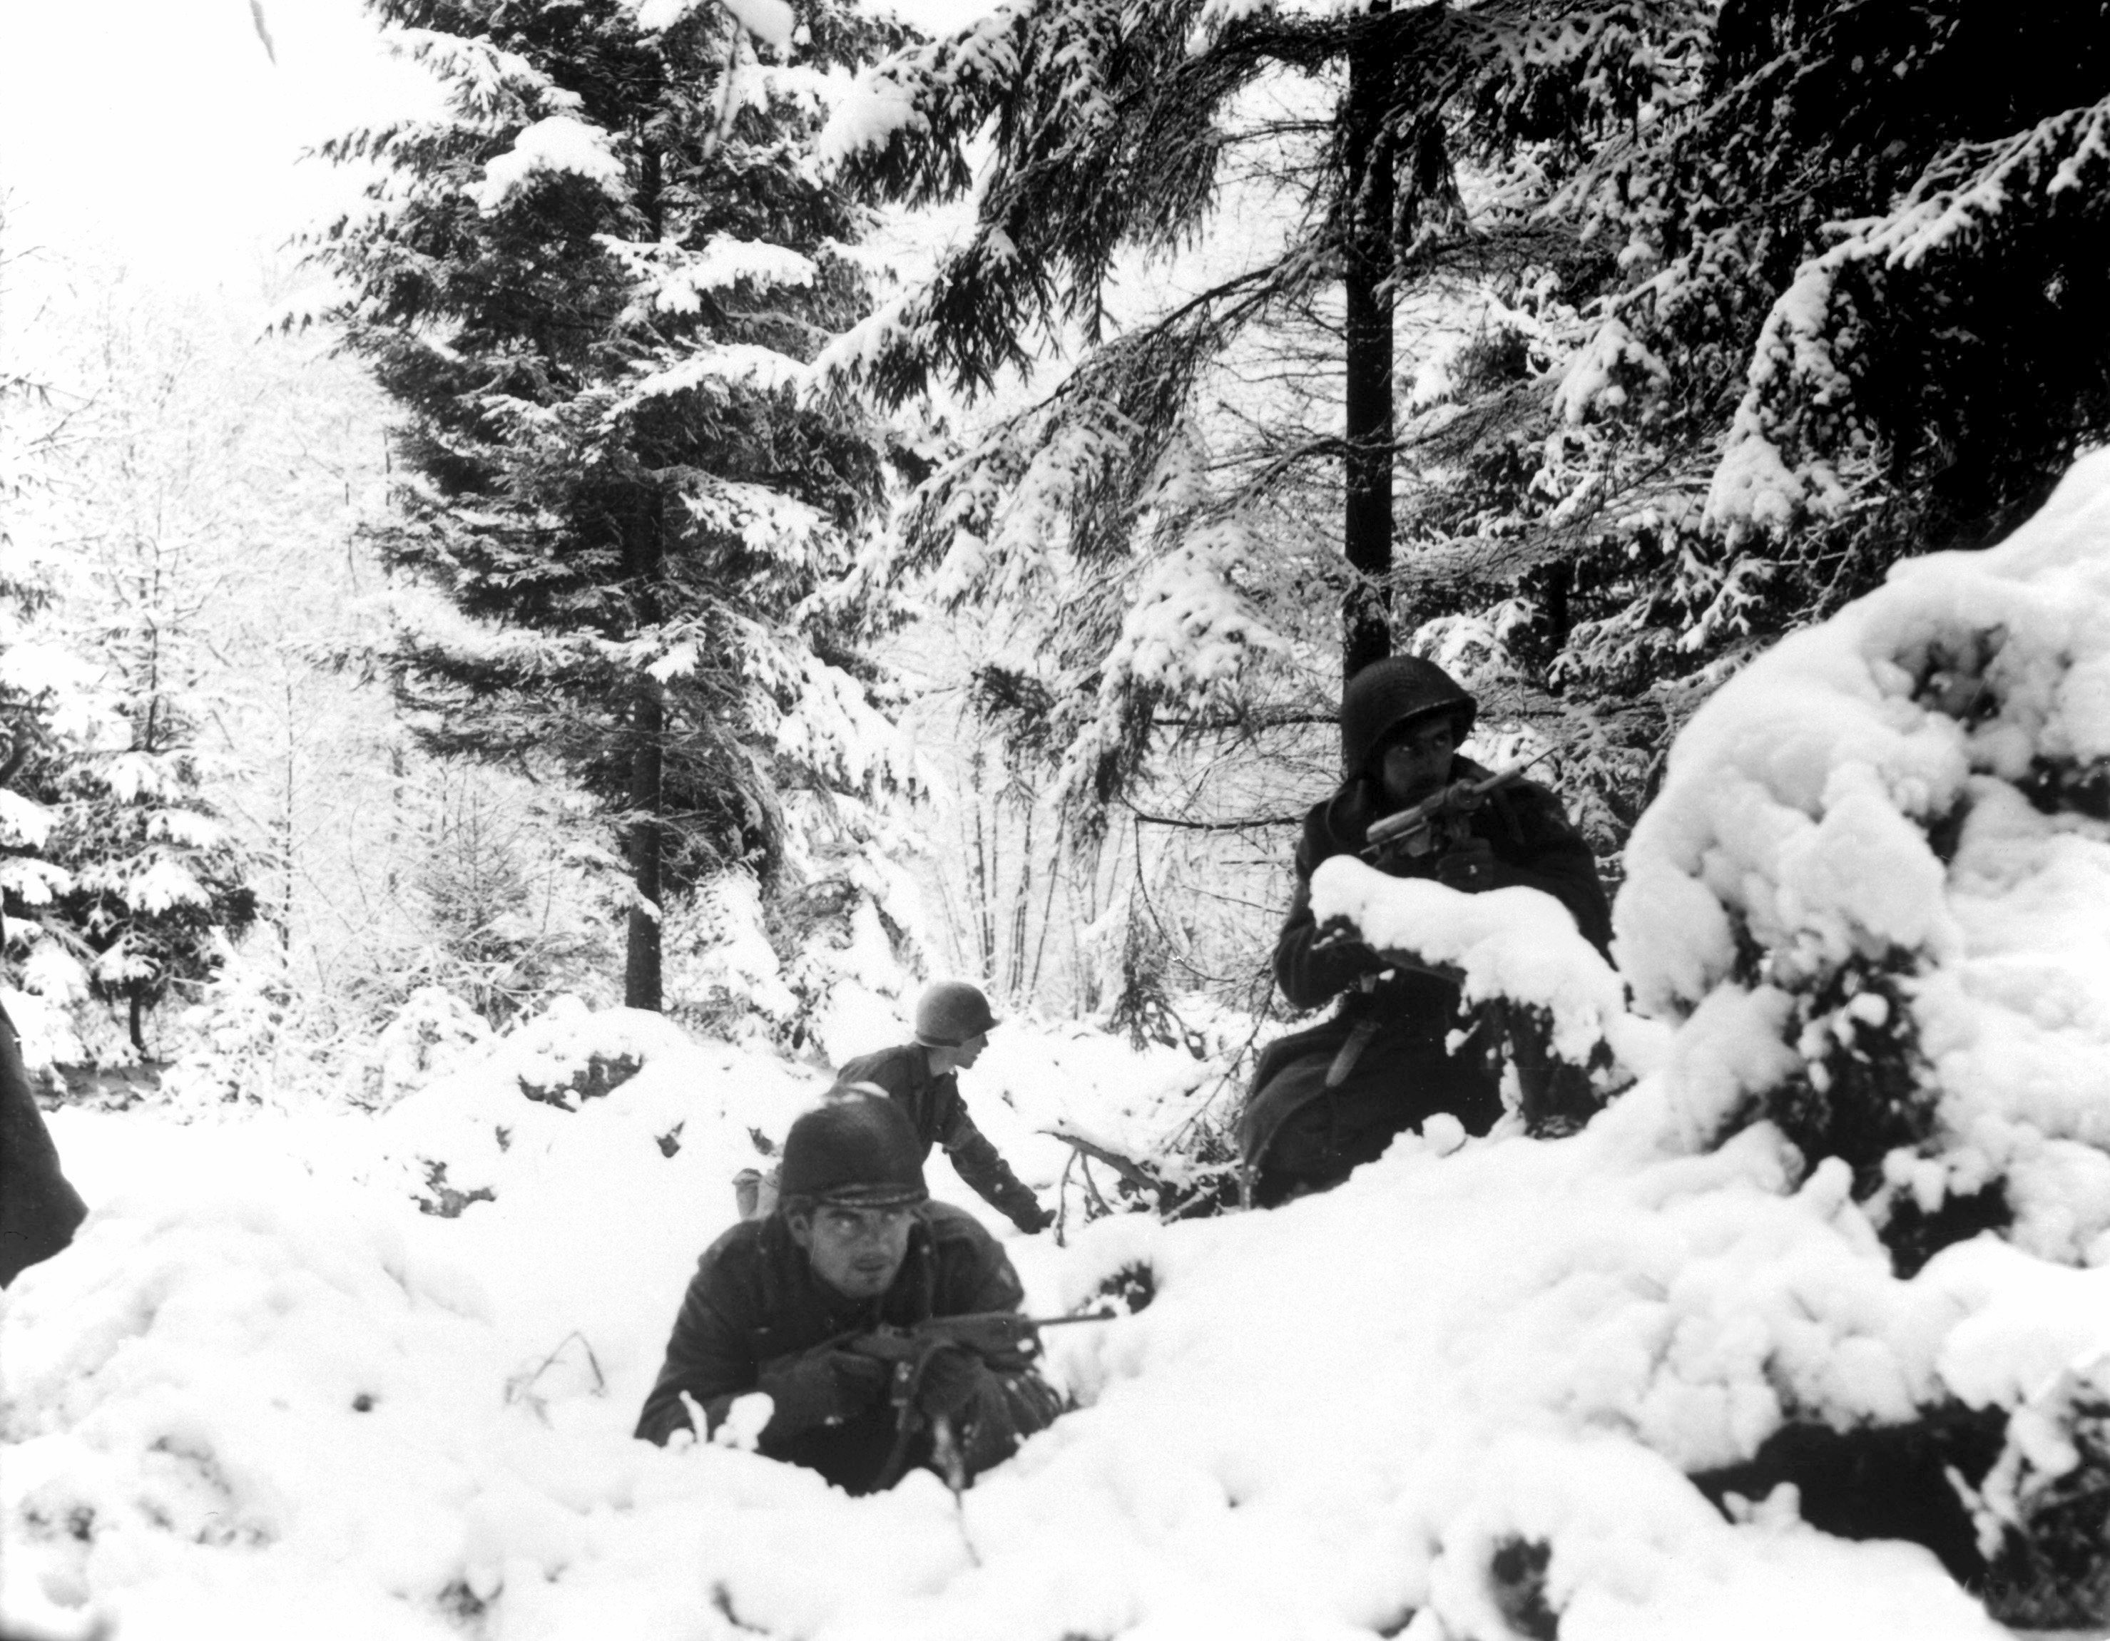
Battle of the Bulge (Dec. 1944)
Germany stages a last ditch offensive
  Sends 250,000 troops to the front line
  Advance 50 miles into Allied territory (bulge)
Allies lose 20,000 troops, Germany loses 100,000 troops
Allies win and essentially defeat Germany and end the war.

